Slide 1
Rethinking the Junior League Membership Experience: A Presentation to Southwest Exchange
Presented by: Anne Dalton, AJLI Chief League Operations Officer
2018 Southwest Exchange Conference
Los Angeles, CA
Saturday, September 8, 2018

Slide 2
Objectives:
Understand the changing expectations of today’s Junior League Member
Learn the elements of a new “member-centric” engagement model
Design the way forward
1
2
3

Slide 3
Our “State of the Union”
Research conducted in 2005:
INTERNAL TRENDS
Declining membership
Eroding Junior League community impact
Inflexible, hierarchical membership structure
EXTERNAL TRENDS
Explosive growth in nonprofits=competition
Demand for civic leaders
Increased focus on women’s development

Slide 4
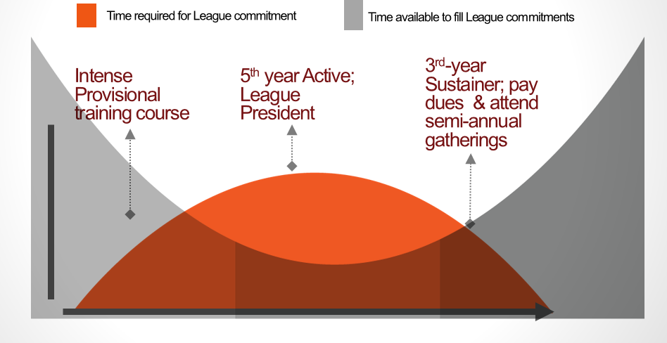
How Did We Get Here?
Our current model asks the most when busiest – the least when less busy
Notes:
So lets first talk about why we are participating, as you can see here this is a graph demonstrating that within our current structure we are asking for the most time from our members when they are typically the busiest. We know women’s lives have changed dramatically over the last 100 years and the one size fits all approach no longer applies. So what does the new model suggest….

Slide 5
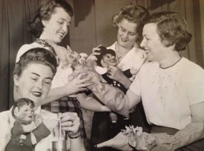
How Things Have Changed
vs
Leveraging Our Members’ Experiences
Employed
Families (in all stages)
Extensive volunteer experience and education when she joins
One Size Fits All
Members lacked community knowledge
“Command and control” leadership
Our “chronological” lives

Slide 6
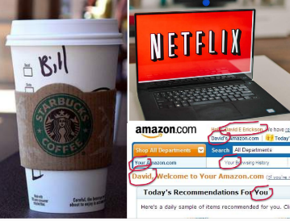
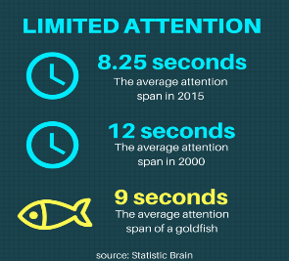
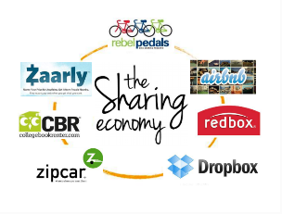
The Expectations of Today’s Members
Notes:
Our current, and particularly our future member is expecting a customized experience
8 sec attention span
an expectation we are not meeting
For Millennials, technology is a part of everyday life. They grew up using smartphone, tables and they are accustomed to a lifestyle that is always “on” and where info is always readily available
“Millennials are looking for authentic ways to make a difference. That means they want transparency, they want immediacy, and they want to be a part of the critical equal. The more direct the interaction, the powerful the experience. Millennials want to be able to see the change personally.” Saul Garlick, the organization’s founder and CEO, Think Impact
The era when associations could count on members joining and renewing, has passed. “The End of Membership as we Know it” Sarah Sladek
84% of millennials make charitable donations, 77% volunteer
61% of millennials are worried about the state of the world and feel personally responsible to make a difference. [Huffington Post)
84% say that helping to make a positive difference in the world is more important than professional recognition. [Bentley University’s Center For Women And Business]
By next year, millennials will account for 36% of the U.S. workforce and by 2025, they will account for 75% of the global workplace. [U.S. Bureau of Labor Statistics / The Business and Professional Women’s Foundation]
Millennials have surpassed Baby Boomers as the nation's largest living generation, according to population estimates released this month by the U.S. Census Bureau. Millennials, whom we define as those ages 18-34 in 2015, now number 75.4 million, surpassing the 74.9 million Baby Boomers

Slide 7
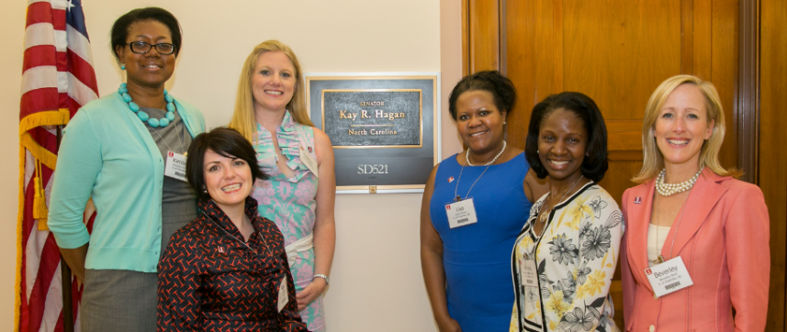
Our Transformation Goal
A network of women empowered as
leaders creating community change
Notes:
So let’s remind ourselves of what the overall transformation goal is. This was in fact the vision of Mary Harriman when she founded the JL back in 1901. Since then the world looks quite a bit different than it did over a hundred years ago and women’s lives have changed as well. So AJLI took a look at how those changes are impacting us and came to the conclusion that they needed to look at some transformative practices to modernize us and continue to move us forward so we can in fact be a network of women empowered as leaders creating community change.

Slide 8
Our Transformation Approach
Meaningful Community
Impact
A STRONG LEAGUE
Member-centric Member
Experience
Well-run
League
Notes:
So how do we accomplish this and what defines a strong league…..
*It begins with ensuring that the Community Impact piece is meaningful. Many leagues have participated in the community impact transformation rollout. This will transform the leagues and how they relate to their community work and its impact. This is one way we can create a strong league.
*The 2nd way to create a strong league is through a well-run, efficient league. Similarly to the community impact rollout many leagues have also participated in the governance and management rollout, the focus of which is to transform the board into a strategic body focused on the overall positioning of the league not just for today but for the long term as well. Teaming up with the board will be a very strong management team and their focus is the day to day implementation, so in other words the actionable items that support the BOD’s overall strategy. The management team is focused on the operational piece of running the league and the BOD is focused on strategy. Within the governance and management rollout we are suggesting that these roles are split from one another and that they are maintained.
*The 3rd way to create a strong league is by transforming the member experience. At its core the new membership model is member-centric which creates a more meaningful experience for each member and which also better supports lifelong membership given that’s its focused on the member and their engagement within the league.
As you can see these three circles are not independent from one another and are intertwined which demonstrates visually how these three efforts together are the way in which we are moving forward to facilitate a healthy league for the short term and the future.

Slide 9
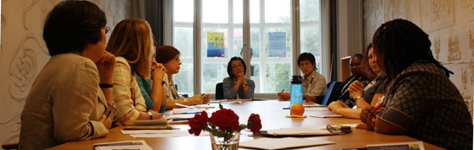
Why Strategic Transformation?
To ensure the long-term health, vitality and viability of The Junior League for generations of civic leaders to come

Slide 10
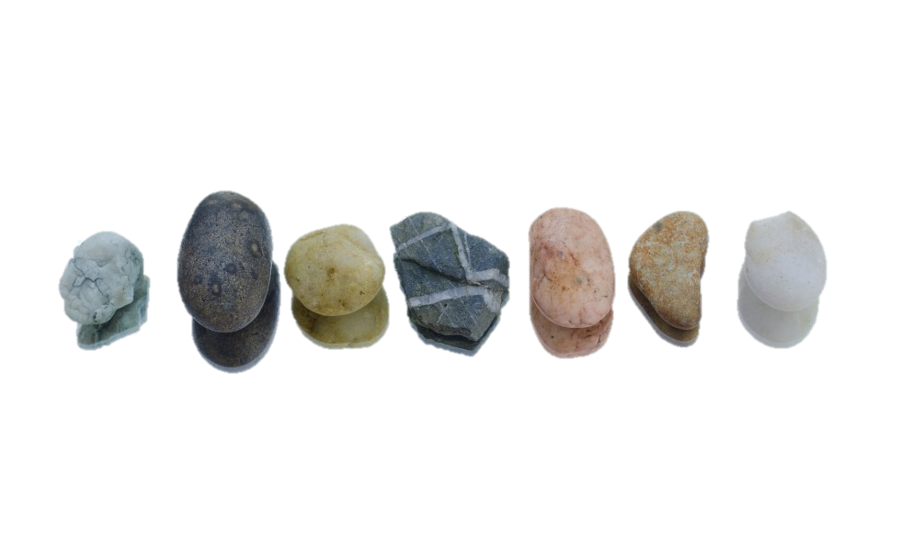
Member-centric Means…
“… moving beyond traditional models in which Members are seen as a body to be managed.
Instead Members represent a dynamic pool of individuals with skills and talents who act as a resource and serve as potential co-authors of the League’s future.”
Notes:
As our members, community, and technologies have evolved, we’ve also seen our League evolve. In some ways, we’ve experienced tremendous positive growth. In other ways, we’ve strayed a bit from our two-pronged mission of developing women and improving our community. So keeping these two things front and center, along with the member-centric approach, we’re going to spend the afternoon taking an honest look at our systems and processes.

Slide 11
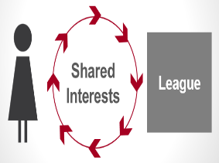
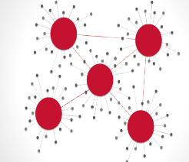
Critical Elements of the New Membership Model
Voice & Choice
Talent Deployment & Development
Multiple Meaningful
Connections
Notes:
Here are the three critical elements of the new model. First I’m going to walk you through each concept and then later in this presentation I’ll also talk about what the tactical pieces are and how in the rollout they walk us through each step to operationalize these new concepts.

Slide 12
The Membership Experience: New Framework
Voice and Choice
Voice in strategic direction
Choice in level of engagement
Talent Deployment
Match Members’ interests with programs / activities that support Member’s development goals
Multiple Connections
Opportunities for meaningful connections of greatest interest to the Member
Notes:
Thus our challenge around the Membership Experience was significant. How do we shift from a “one size fits all” process to one that leverages the experiences women bring to the Junior League while still offering opportunities for new and deepened experiences and opportunities. How do we sustain the connections among and between members when we are now part-time volunteers with myriad other responsibilities and interests outside of the Junior League. How do we ensure the flexibility that our lives demand today; a flexibility that needs to be decided by the member based on her circumstances and cannot be standardized or “earned”. How do we ensure that the work of the League…the experiential learning coupled with formal skill development that has been our cornerstone from the beginning, effectively supports a member’s personal and leadership development goals and interests.

Slide 13
It Begins With the Member Compact
An annual commitment built on shared interests of the Member and the League
Through the Member Compact, the Member:
Affirms her commitment to the JL Mission
Indicates how much time she has to give
Agrees to work with the League to put her talent deployment / development plan together
Commits to stay connected with the League
Pays her dues
Notes:
The new model is moving entirely away from a “one size fits all” requirements based model to a more flexible, member-centric model that is more fluid. Although we are moving away from requirements IT IS NOT COMMITMENT FREE.
Through the signing of a member compact the concept of “Voice and Choice” comes to life. This gives the member an opportunity to have a say in not only how much time she gives for the upcoming league year but also how she will give her time. After a behavioral interview is conducted (pre-placement timeframe) the member and the league will agree to her commitment for the year (placement). This creates an experiential learning opportunity for the member given that the placement is a result of learning more about her skills, aspirations and interests. Keep in mind its not just about what the member wants as this also benefits the league tremendously because they are better able to deploy talents effectively to drive the most impact and get the work done. It’s a “win, win”.

Slide 14
Why Member Interviews?
Makes Members feel valued and heard
Helps with placement decisions, leading to a more satisfying membership experience
For interviewers, an opportunity to gain new skills

Slide 15
Member Interview Goals
To draw information from a member’s skills, actions and likes/dislikes to determine:
Core competencies
Interest
Commitment
To create a two-way conversation to establish shared expectations for League placements

Slide 16
Talent Deployment and Development
Focus on effectiveness and efficiencies of talent deployment and development
Use of “placement” as experiential learning
Job descriptions specify how work is organized as well as skills to be utilized or learned
Formal learning opportunities connect directly to developing community and civic leadership

Slide 17
It’s All About CONNECTIONS!
One size does not fit all
It’s a mix of small and large, formal and informal, educational and ‘just for fun,’ League-organized and Member-organized
It’s a mix of within the League and across the Association

Slide 18
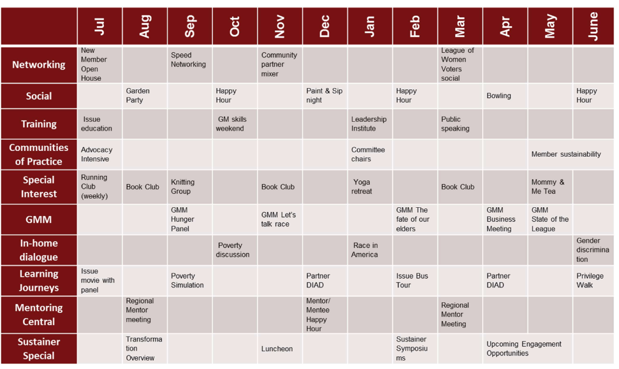
Sample Opt-In Calendar

Slide 19
“Make Meetings Worth My Time!”
What makes a General Membership Meeting GREAT?

Slide 20
Membership Rollout Target Outcomes
Member’s voice/choice is reflected in the League’s strategic direction and work
Members are able to adjust their League commitment to the time they have available
Members are able to contribute their talents effectively and efficiently to the League’s work
Members have opportunities to develop their knowledge and skills for community and civic leadership
Members have a variety of opportunities to connect with others within the League and the Association
Members are satisfied Junior League Members

Slide 21
Debunking the MYTHS
MYTH #1 The new membership model is commitment-free.
MYTH #2 We are getting rid of GMMs I in the new membership model.
MYTH #3 Nothing will get accomplished because there are no requirements.
MYTH #4 The change happens immediately.
MYTH #5 We are eliminating membership categories.

Slide 22
What’s intriguing?
What’s puzzling?

Slide 23
Start the conversation…..

Slide 24
Thank you! Adalton@ajli.org

