Slide 1
The Junior League Board: Setting Strategic Direction: A Presentation to Southwest Exchange
Presented by: Anne Dalton, AJLI Chief League Operations Officer
2018 Southwest Exchange Conference
Los Angeles, CA
Saturday, September 8, 2018

Slide 2
Objectives:
1
Understand the planning continuum
Clarify “who is responsible for what”
Design a planning calendar
2
3

Slide 3
“Plans are useless;
planning is everything”
(Dwight David Eisenhower)

Slide 4
Why a continuum rather than a plan?
Planning is a process not an event
It matters where you end up
It matters how you get there
It contributes to membership satisfaction and engagement …..really it does!!!
Member
Satisfaction
Member
Engagement
Member
Loyalty

Slide 5
Getting Started
It starts and ends with a Mission
What if the Junior League of (your name) didn’t exist? Would you create it? Why?

Slide 6
A System of Choices
Our aspirations?
Where will we play?
How will we succeed?
What capabilities do we need to succeed?

Slide 7
The Beginning
The Big Picture
Impact
Visibility
Sustainability

Slide 8
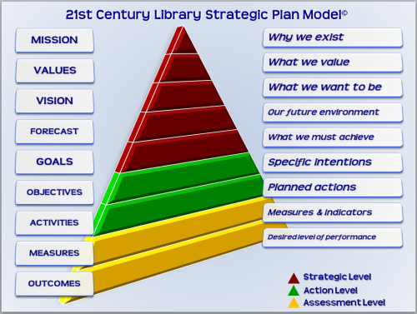

Slide 9
The Continuum
Mission
Vision
Values
Annual Plan
Tactical/Activity Plans
Long-Term Strategy

Slide 10
The Annual Plan
Builds on what went before
Encompasses all that must happen @ the level of objectives
Is not an undifferentiated “to do” list
“Forces” alignment
Controls capacity

Slide 11
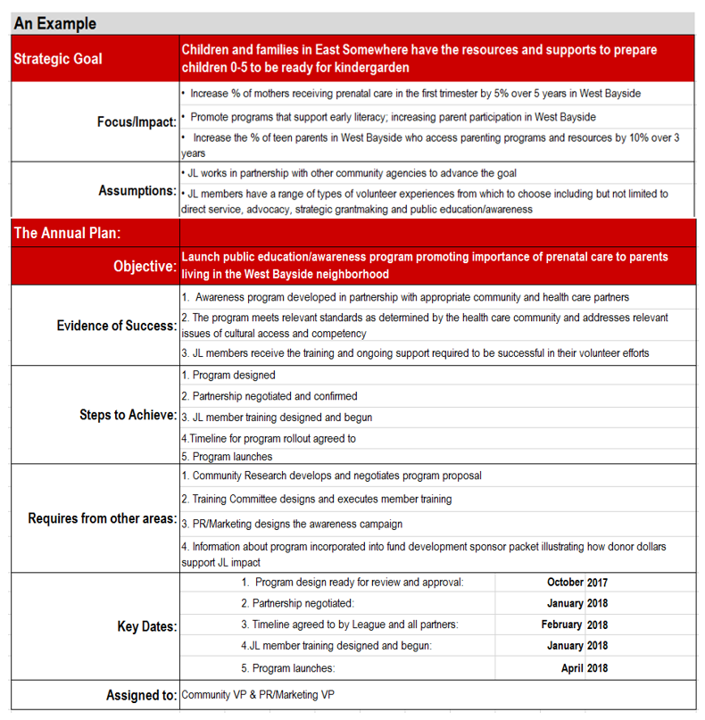

Slide 12
Who does what?
Board:
responsible for strategic direction
undertakes planning to set/monitor long term goals
approves Annual Plan
monitors Annual Plan
President & President-Elect:
assure a planning process is in place
coordinate effort/assures resources
keep “big picture” in sight
“chief” communicators to all publics

Slide 13
Who does what?
EVP/Councils (as a team):
responsible for developing Annual Plan
provide input to long-term planning
report to the Board as scheduled
assure performance @ committee level
Nominating Committee:
slates to the direction in which the League is headed
job descriptions focus on the capacities necessary to operationalize the plan
work with Board and Management to build pipeline

Slide 14
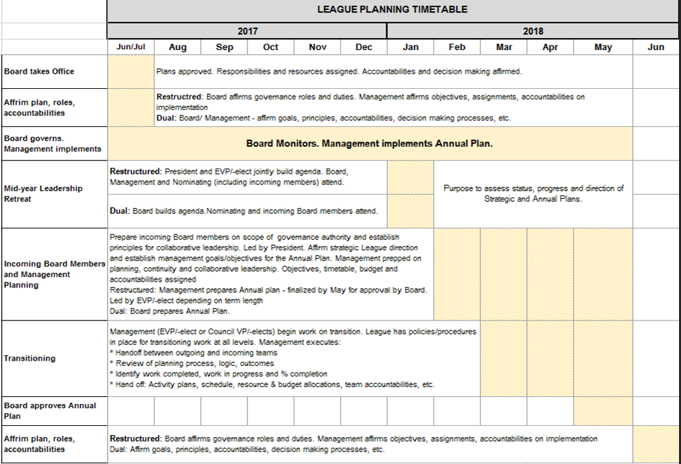
A Board Planning Calendar

Slide 15
Issues to Consider
Board’s focus is on why/what; Management’s focus is on how
Transitions are essential to success
Things must overlap rather than start/stop
Leaders keep things moving… …forward

Slide 16
Questions?

