Slide 1
Junior leagues welcome GENERATION z
Southwest exchange
Vicki clark
Building the capacity of organizations
Memphis, TN
September, 2018

Slide 2
JUNIOR LEAGUEs ON A MISSION DEVELOPING “women” LEADERS
Our Mission
The Junior league is an organization of women committed to promoting voluntarism, developing the potential of women, and improving communities through the effective action and leadership of trained volunteers. Its purpose is exclusively educational and charitable.

Slide 3
JUNIOR LEAGUES All women

Slide 4
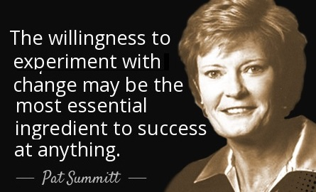
WHAT’S CHANGED? EVERYTHING
WOMEN
COMMUNITY ISSUES
TECHNOLOGY
GIVING PATTERNS
FUND DEVELOPMENT
GOVERNANCE
VOLUNTEER ENGAGEMENT/MEMBERSHIP STRATEGIES
NONPROFIT MANAGEMENT
LEADERSHIP
JUNIOR LEAGUES

Slide 7
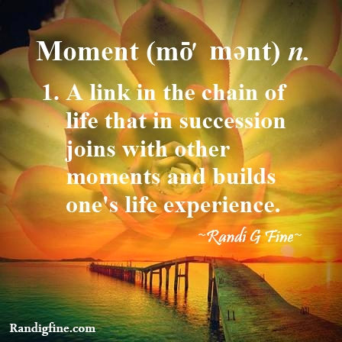
DEFINING MOMENTS
Key things that have affected gen z include :
the Great Recession impacting their parents
student loan debt becoming a crisis in America
the Affordable Care Act becoming law
growing up with an African-American US president
gay marriage becoming legal
medical marijuana becoming legal in many states
there have “always” been twentysomething entrepreneurs who are billionaires.
Baby Boomers are their grandparents rather than their parents
9/11- Hurricane katrina

Slide 8
have lived their “entire” lives on line
many have no memory of life before smart phones, so you’d better have a strong game plan for communicating via mobile if you want to bring them on board.
96% own a smartphone
85% learn about “products” through social media
Have never known life without google
Also called “IgEN”
Digital integrators
screenagers

Slide 9
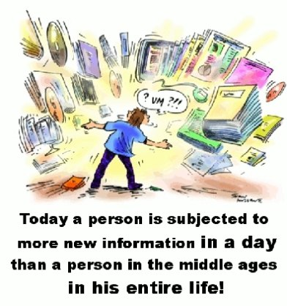
INFORMATION “OVERLOAD”
Experts have summed up Gen Z’s approach to processing information as
‘Blink, Share, Laugh, Forget.’ Spend any time with Gen Zer’s ripping through their smartphones, and that description likely resonates.
And it’s not surprising. Gen Zers have lived their entire lives awash in a flood of information and messaging. In many ways, ‘Blink, Share, Laugh, Forget’ represents the only logical way to process information and navigate through a day.

Slide 10
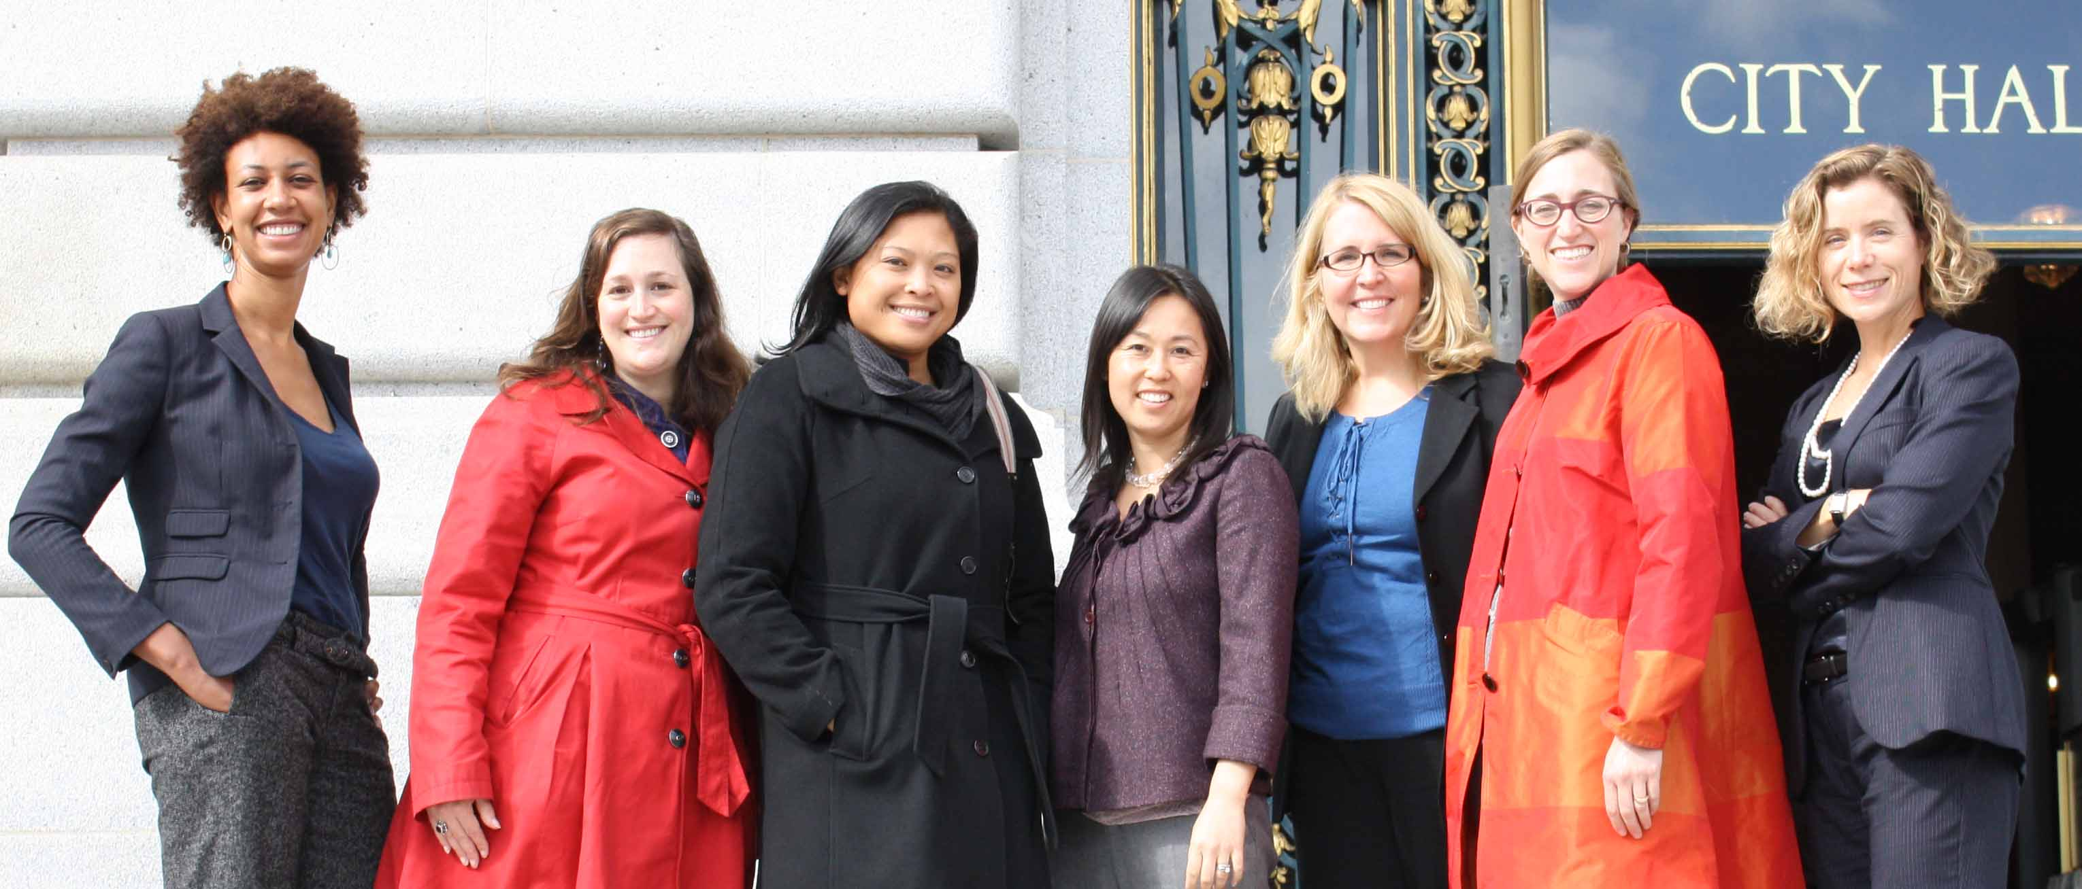
The Top 5 Traits Gen Z Looks For In Leaders
Inclusivity
Curiosity
Self-motivation
Generosity
perseverance
What we do best is develop the potential of women as civic & community leaders

Slide 11
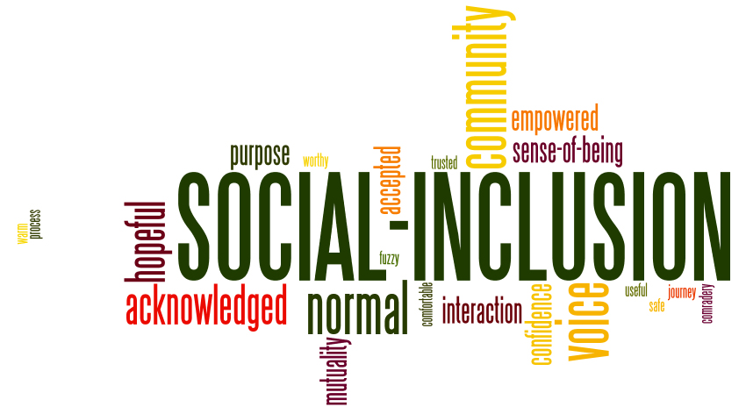
1. INCLUSIVITY
Gen Z-ers are used to being part of massive digital and social communities, and they value the opportunity to connect with and learn from different types of people. Gen Z-ers are inspired by individuals who want to include them in their journeys, rather than demand that they watch from afar.

Slide 12
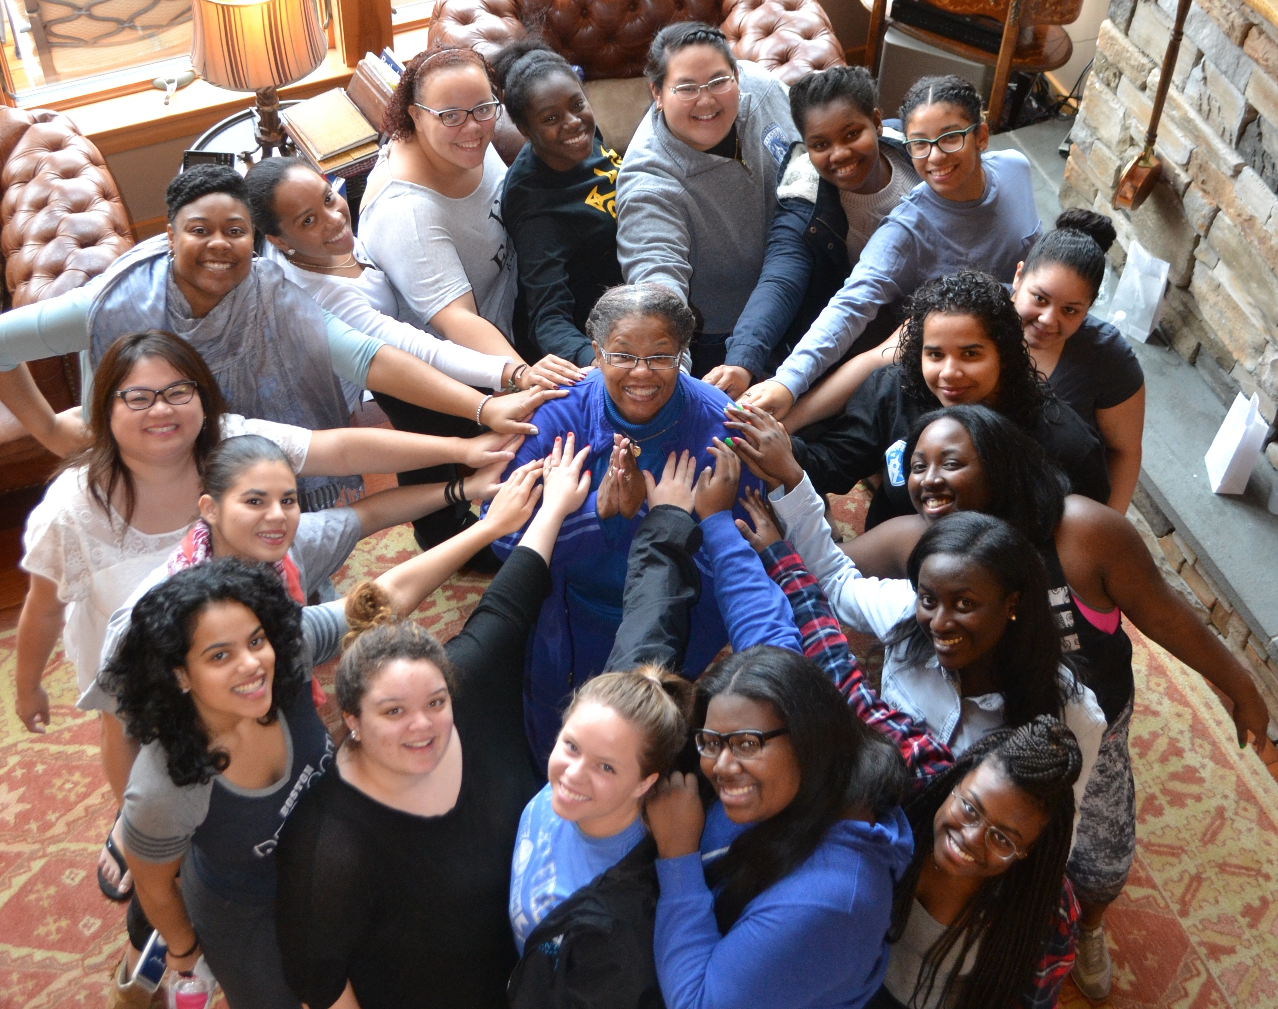
Racial & Ethnic diversity is their norm

Slide 13
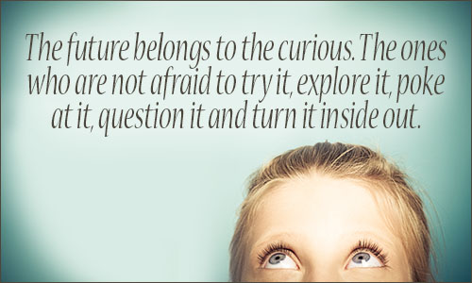
2. CURIOSITY
Unlike their parents’ generation, Gen Z-ers have no interest in being boxed into one path or role. Rather, they understand that their interests and goals today are likely to evolve over the course of their LIVES. To prepare themselves, they ARE DRAWN TO cultures & individuals who value constant education and curiosity.

Slide 14
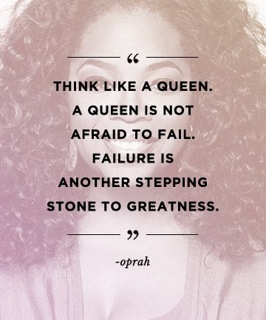
NOT AFRAID OF “FAILURE” learners in a training organization
71% expect to experience significant failure before achieving success, and nearly 40% say they see failure as an opportunity to try again.

Slide 15
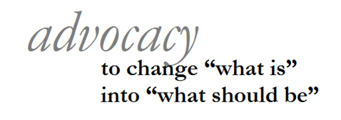
Passionate about causes & ISSUES
A June 2018 survey by Fuse, finds that Gen Z is passionate about the causes it supports. More than a quarter of Gen Zers say they have attended protests or rallies or boycotted a company in the last year.
Perhaps more telling is this fact — more than 2 in 5 Gen Zers say they have educated family or friends about a cause.
More than ½ believe voting is “very important”

Slide 16
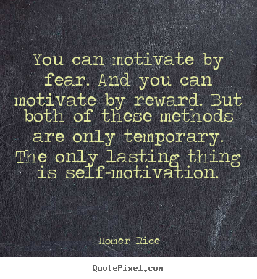
3. SELF-MOTIVATION
groups who offer Gen Z employees the freedom and responsibility to fulfill their duties at their own discretion through remote working solutions and flexible time-frames will not only attract young talent but will also stand a better chance of holding on to young talent. They are eager to work on their “passion projects” outside of their “professions”. Respond well to self-motivation through flexibility.

Slide 17
PRIZE INDIVIDUALITY OVER CONFORMITY

Slide 18
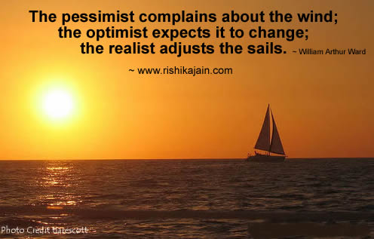
Realistic & driven
Forbes magazine suggested the optimism of Generation Z is curbed by a sense of realism. They grew up in a world shaped by 9/11 and hurricane katrina. GEN Z BELIEVES THEY CAN & WILL MAKE A DIFFERENCE IN THE WORLD.

Slide 19
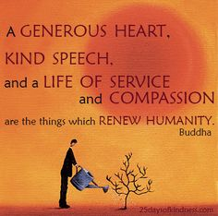
4. generosity
As a generation that craves authenticity and community-building, it’s no surprise that Gen Z want to be in groups who are committed to giving back. Being social natives has given this generation the opportunity to better understand the challenges affecting individuals, and entire communities, outside their own circles and regions.
As a result of this access and transparency, Gen Z-ers want assurance that the companies they buy from, work for and are involved in are committed to more than just growing their bottom line, that they are also committed to helping others improve their lives through philanthropic initiatives.

Slide 20
PHILANTHROPY GOES DIGITAL
find causes they are passionate about and get ideas for how they can support;
educate their friends and family about their causes;
connect with others who share their passions;
engage in crowd-funding;
make microloans through sites such as Kiva
text donations via their phones;
create and post videos to promote their issues;
apply for grants to support their philanthropic projects;
find volunteer opportunities or engage in online volunteering.

Slide 21
Already involved in volunteering
A study conducted by the marketing agency Sparks & Honey found 26 percent of Gen z already volunteer. The report also discovered they are more engaged in global affairs than previous generations.
About 60 percent of all Generation Z members polled wanted to have an impact on the world, compared to 39 percent of millennials. while this new generation is described as active volunteers
77% of Gen Z’s are either extremely or very interested in volunteering to gain work experience. [Millennial Branding / Internships.com]
26% are currently volunteering. [Intern Sushi / CAA]
76% are concerned about man’s impact on the planet. [JWT]

Slide 22
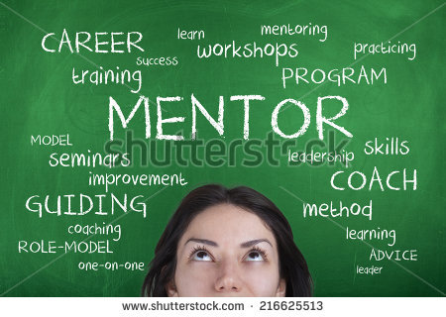
5. perseverance
Gen Z-ers may be young, but they are not naive. They want to work hard for their personal successes and they understand that the path to success will not be smooth. They want to be with others and in groups that are transparent about their own struggles and roadblocks gives young Gen Z professionals the chance to better prepare themselves for the types of obstacles they are likely to face.
this demographic wants mentorship and understands that being with leaders who are willing to talk about their own paths will allow them to forge mentor-mentee relationships that may last for the entirety of their lives.

Slide 23
collaborative
60% of Gen Zers say they like to share their knowledge with others. a sign of collaborative skills.

Slide 24
loves “StorIES”
“This generation loves stoRIES,” Marcie Merriman, Ernst & Young’s executive director, cultural relevancy and brand strategy said in a recent interview. “What’s the history behind it? Why is it relevant? What does it mean to me?”
It makes sense. Stories are a way to differentiate your content from all that other information that Gen Z quickly forgets. Even better, a good story works for people of any generation.
So look for the story—something that provide context and meaning.
Then find the best way – and medium – to tell it.

Slide 25
IN THE JUNIOR LEAGUE

Slide 26
The Center for Generational Kinetics solves tough generational challenges with Gen Z, Millennials, Gen Y, Gen X, and Baby Boomers. Our custom research, speaking, and strategic consulting deliver innovative, practical solutions that drive results.
genHQ.com/Gen-Z
CONTACT : genhq.com
+1 512-259-6877 Info@GenHQ.com
8733 Shoal Creek Boulevard Austin, Texas 78757 USA

