Slide 1
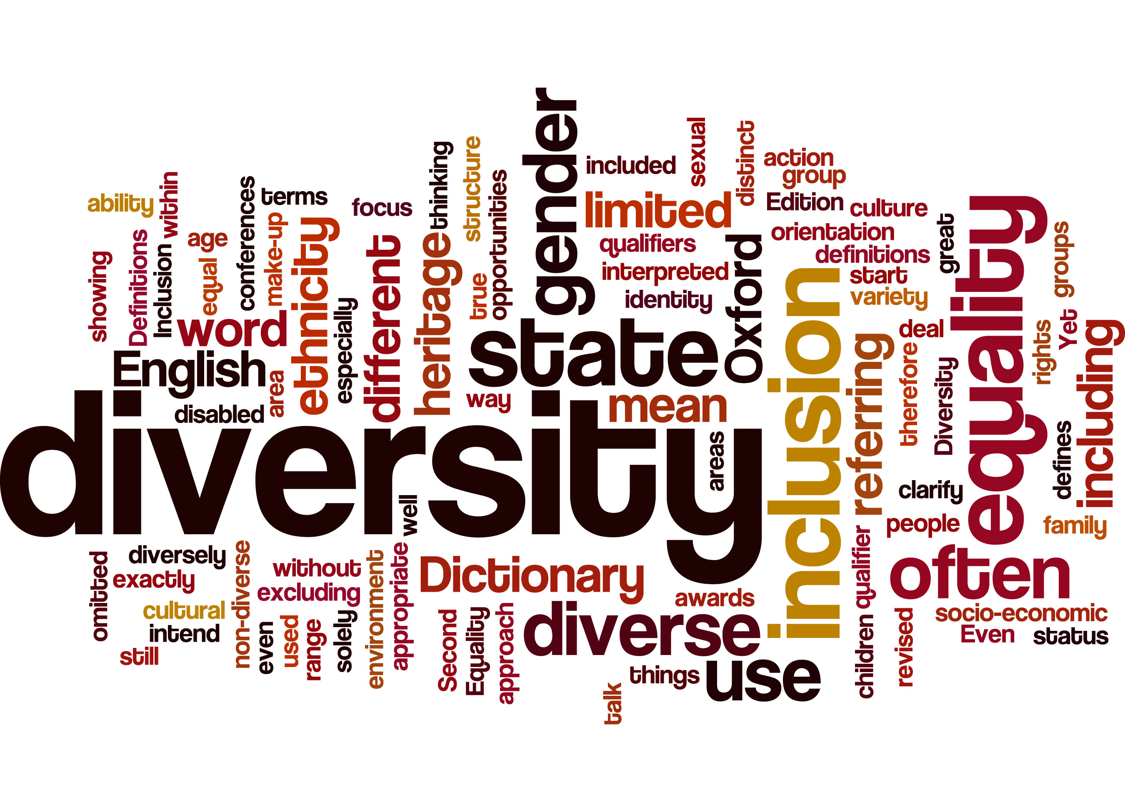
“WOMEN LEADING THRU INCLUSION”
Southwest Exchange
Vicki clark
BUILDING THE CAPACITY OF ORGANIZATIONS
MEMPHIS, tn
september, 2018

Slide 2
VISIONARY MISSION DRIVEN LEADERS
Our Mission
The Junior League is an organization of women committed to promoting voluntarism, developing the potential of women, and improving communities through the effective action and leadership of trained volunteers. Its purpose is exclusively educational and charitable.

Slide 3
LEADERS WITH A COMMITMENT TO DIVERSITY AND INCLUSION
Our Commitment to Diversity and Inclusion The Junior League welcomes all women who value our mission. We are committed to inclusive environments of diverse individuals, organizations, and communities.

Slide 4
ALL WOMEN…

Slide 5
SOCIAL AND CULTURAL INCLUSION
THE JUNIOR LEAGUE EXPERIENCE SUPPORTS THE DEVELOPMENT OF WOMEN AS COMMUNITY AND CIVIC LEADERS WHO:
DEMONSTRATE THAT PEOPLE OF DIFFERENT CULTURES, BACKGROUND, EXPERIENCES, AGES, INTERESTS AND VIEWPOINTS BRING VALUE TO DISCUSSION;
ARE COMMITTEED TO LEARNING ABOUT & LEARNING FROM VARIOUS SEGMENTS OF MEMBERSHIPS AND THE COMMUNITY, INCLUDING THOSE WHO ARE IMPACTED DIRECTLY
ARE COMMITTED TO CREATING SHARED SOLUTIONS
ENGAGE IN REFLECTION AND INQUIRY TO BECOME AWARE OF AND SENSITIVE TO THE HISTORY AND CONTEXT THAT IMPACT A SITUATION; AND
UPHOLD PRINCIPLES AND PRACTICES THAT REFLECT AND SUPPORT DIVERSITY AND INCLUSION THROUGHOUT THE LEAGUE, & CULTURE THAT IS TRANSPARENT, RECEPTIVE, RESPECTFUL AND RESPONSIVE

Slide 6
WE’RE ALL CONNECTED… Whether We Want To Be or Not

Slide 7
Sex/Gender
Race/Ethnicity
Other (Bi/Multi-racial)
Other
Intersex
Hispanic/Native American
Socioeconomic Status
Transgender
Asian-American
Sexual Identity
Other
Female
African-
American
Non-working Poor (Welfare)
Asexual
Learning/
Attention*
Central/South-American
Born
Bisexual
Lower Class (Working Poor)
White
Middle Class
Male
Language
Gay/Lesbian
Upper
Class
Upper-Middle
Class
Straight
Social
Privilege,
Power & Status
e.g. Access to
Opportunities/
Resources
Native Origin
U.S.
Born
Catholic
English
Religion
Agnostic
Other
Jewish
North American
(non-U.S.) Born
Ability
Muslim, Hindu, or
Atheist
Able
British/European
Born
Foreign/
Fluent in English
Moderate English
Foreign/Minimal
English Speaking Ability
African/Asian-Pacific Born
Sensory Disability
No English Speaking Ability
Physical Disability
Mental/Psych Disability
*Learning or Attention
Disorder (e.g. ADHD)
SWGS 6050: Oppression & Social Justice

Slide 8
““LET’S GO”… OUR PATHS ARE DIFFERENT ET’S GO”…
“LET’S GO”…

Slide 10
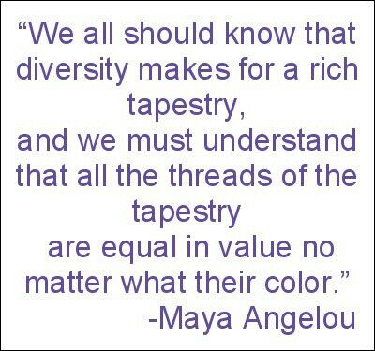
NO MORE MELTING POT

Slide 11
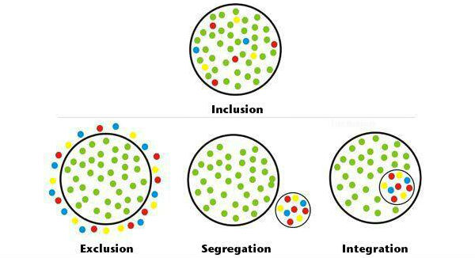
INCLUSION…MEANS WITH NOT JUST IN
THE VALUE AND PRACTICE OF ENSURING THAT PEOPLE FEEL THEY BELONG.
ALL MEANS ALL WOMEN

Slide 14
INCLUSIVE LEADERS DON’T SHY AWAY FROM REALITY

Slide 15
Individual Cultural Competence
At the Individual Level
Cultural Competence IS:
an examination of one’s own attitude and values, and the acquisition of the values, knowledge, skills and attributes that will allow an individual to work/function appropriately in cross cultural situations.

Slide 17
The understanding of diverse attitudes, beliefs, behaviors, practices, and communication patterns attributable to a variety of factors (such as race, ethnicity, religion, SES, historical and social context, physical or mental ability, age, gender, sexual orientation, or generational and acculturation…
CULTURAL COMPETENCE

Slide 18
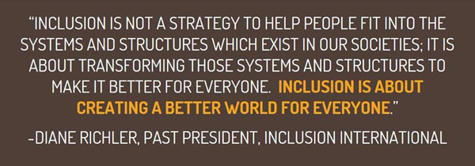

Slide 19
Continuum of Cultural Competency In Organizations
Cultural Proficiency
implement changes to improve services based upon cultural needs
Cultural Competence
recognize individual & cultural differences, seek advice from diverse groups, hire culturally unbiased staff
Cultural Pre-Competence
explore cultural issues, are committed, assess needs of organization and individuals
Cultural Blindness
differences ignored, “treat everyone the same,” only meet needs of dominant groups
Cultural Incapacity
racism, maintain stereotypes, unfair hiring practices
Cultural Destructiveness
forced assimilation, subjugation, rights and privileges for dominant groups only

Slide 21
BIASES ARE OFTEN: HIDDEN/UNSCONSCIOUS/AUTOMATIC

Slide 23
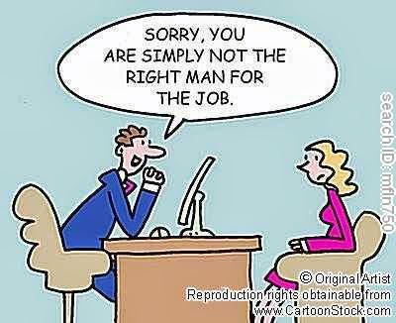
7 STEPS TO IDENTIFY & ADDRESS UNCONSCIOUS BIAS
1. Recognize that we all have biases.
2. Identify what those biases are.
3. Dissect your biases.
4. Decide which of your biases you will address first.
5. Look for common interest groups.
6. Get rid of your biases.
7. Be mindful of bias kick back.

Slide 24
“CONFIRMATIONAL” BIAS
We make decisions largely in a way that is designed to confirm beliefs that we already have. This phenomenon of “confirmational behavior” occurs unconsciously in both positive and negative ways.

Slide 25
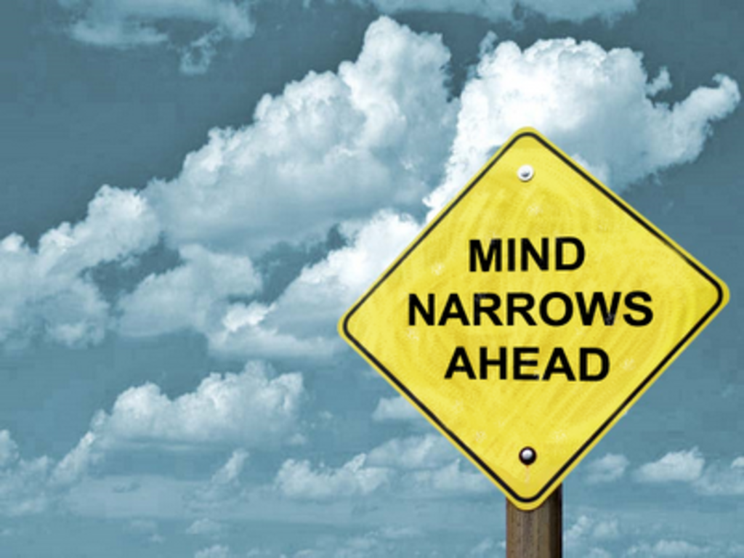
NOT HIDDEN FOR LONG…
HIDDEN BIASES CAN REVEAL THEMSELVES IN ACTION, ESPECIALLY WHEN WE’RE STRESSED, DISTRACTED, IN COMPETITION OR VERY RELAXED

Slide 29
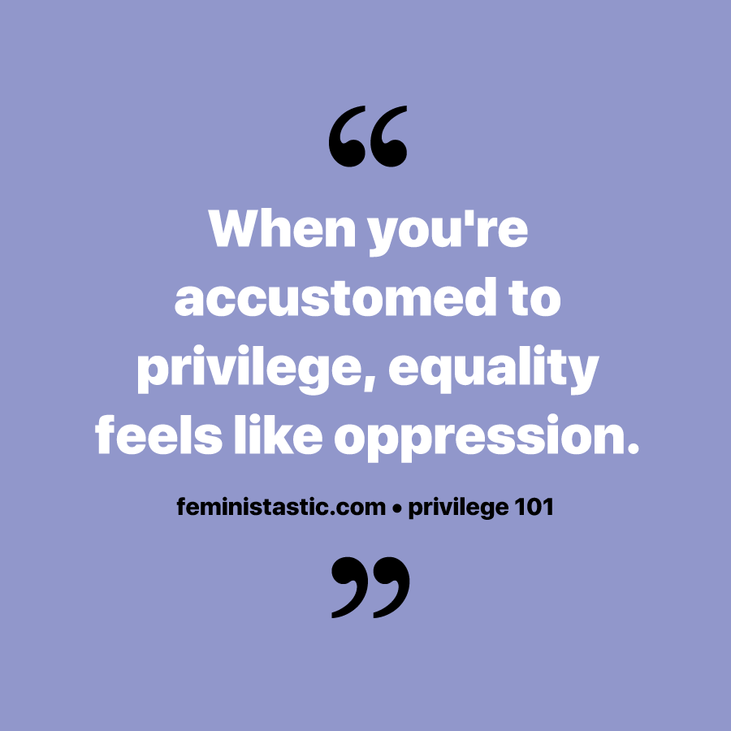
GOT PRIVILEGE

Slide 30
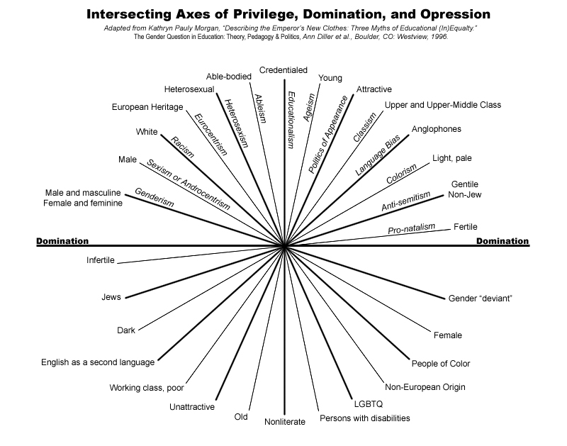

Slide 31
University of San Francisco Check Your Privilege Campaign
“We live in a society that is often oppressive to certain groups of people. However, we all carry particular types of privilege(s) that allow us to advocate for social justice and change in various situations.”
This campaign was designed to begin the discussion around privilege and social inequalities in an effort to raise critical awareness of the institutional oppression often seen in the United States of America. Goals included:
To increase knowledge and improve beliefs about privilege.
To heighten awareness of privilege among the USF community.
To encourage the use of privilege to advocate for others.

Slide 36
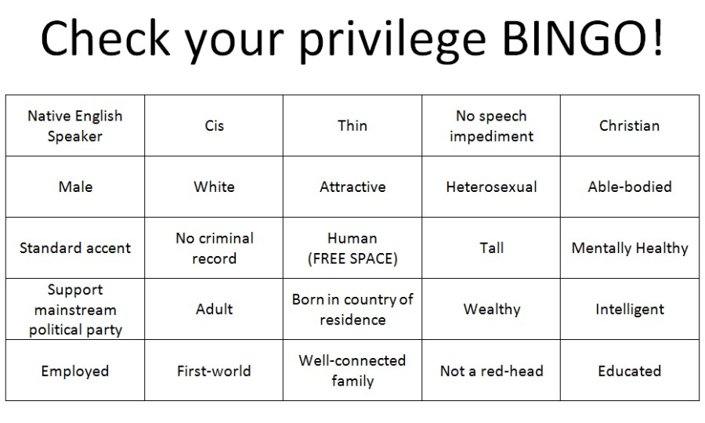

Slide 38
Why Can’t We All Just Get Along???

Slide 40
Now That YOU Know… What Will YOU Do?

Slide 41
BE AN ADVOCATE FOR DIVERSITY, INCLUSION, CULTURAL COMPETENCE

Slide 42
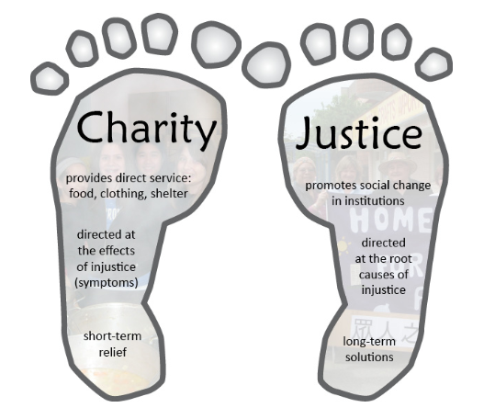
THE MORE WE KNOW THE GREATER IMPACT WE CAN MAKE

Slide 43
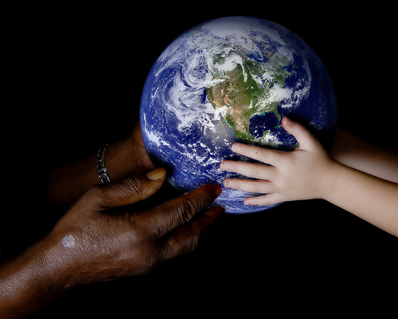
INCLUSIVE LEADERS CREATE A JUST & CARING WORLD

Slide 44
BUILDING THE CAPACITY OF ORGANIZATIONS STAY IN TOUCH
Vicki3525 @vickiclarkconsulting
Vicki Clark
@_VickiEClark

